Slide 1
Pneumonia Prevention
Overview of Clinical Terms & Tips for Data Abstraction
MSTCVS Cardiac Surgery Quality Collaborative
Data Manager Meeting
The Inn at St. John’s
March 11th, 2016
Melissa Clark, MSN, RN
Quality Excellence Leader
Cardiovascular Services
St. Joseph Mercy Hospital, Ann Arbor

Slide 2
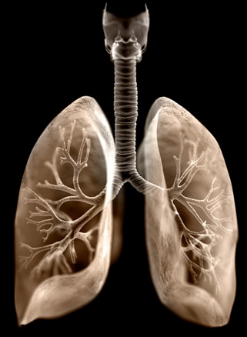
Objectives:
Discuss the clinical terms included in the pneumonia prevention data collection.
Pneumonia prevention data collection tips: where to look in the EMR
©2012 James Archer

Slide 3
Basics of Mechanical Ventilation
A respiratory support modality for patients who are unable to sustain the level of ventilation necessary to maintain oxygenation and carbon dioxide elimination. Indications include respiratory failure, cardiac insufficiency, and neurological dysfunction.
Positive Pressure Ventilation
Most common type of modern mechanical ventilation. Lungs are inflated by exerting positive pressure on the airway, forcing the alveoli to expand during inspiration. Expiration occurs passively.
Pressure Controlled (PCV) vs.
Volume Controlled Ventilation (VCC)
With PCV, the lungs are inflated until a preset pressure is reached.
With VCC, the lungs are inflated to a preset volume, despite mechanical properties of the lungs.

Slide 4
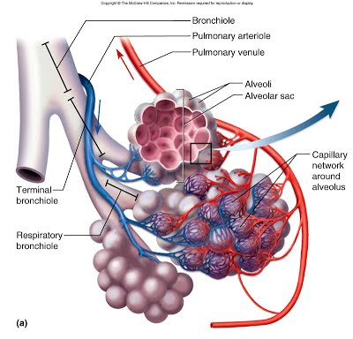
Alveoli
Tiny membranous sacs at the terminal ends of the respiratory tree that allow oxygen and carbon dioxide to move between the lungs and bloodstream

Slide 5
Tidal Volume
The size of the breath that is delivered to the patient.
Measured in milliliters (mL).
Most lung protective protocols call for a set tidal volume of 4-8 mL/kg ideal body weight.
Lung Protective Ventilation
Also referred to as low tidal volume ventilation.
Reduces ventilator-associated lung injury (VALI)
Volutrauma – hyperinflation → shearing injury
Barotrauma – alveolar rupture → pneumothorax
Biotrauma – release of inflammatory mediators → SIRS

Slide 7
Positive End Expiratory Pressure
The application of a fixed amount of positive pressure at the end of expiration.
Collapsed alveoli causes a decreased surface area for gas exchange. Adding higher levels of PEEP (>5 cmH₂O) keeps alveoli inflated during expiration, thus improving gas exchange.
Dangers of PEEP
High intrathoracic pressures can cause decreased venous return and decreased cardiac output.
May cause barotrauma.
May worsen air-trapping in patients with COPD.
https://www.youtube.com/watch?v=iuUSDR4ocCY

Slide 8
YouTube Video Clip on PEEP

Slide 9
Peak Inspiratory Pressure
Highest airway pressure reached during inspiration.
PIP increases with any airway resistance.
The maximum acceptable value of <35 cmH2O is commonly used.
Secretions within the airway can cause flow resistance within the airway, increasing the peak inspiratory pressure.
Pneumonia can decrease lung compliance, causing an increase in peak inspiratory pressure.

Slide 10
Spontaneous Awakening Trials
A period of time during which sedative medications are discontinued.
Analgesics and sedatives are administered to mechanically ventilated patients to achieve maximal ventilatory support by reducing anxiety and pain.
Continuous sedation is often administered until the patient can effectively breath on their own.
However, continuous sedation has been associated with prolonged length of mechanical ventilation, ICU stay, and hospital stay.
Sedation is discontinued and patients are allowed to wake up and achieve a normal level of alertness. If they become responsive to voice without signs of intolerance, they ‘passed’ the trial.

Slide 11
Spontaneous Breathing Trials
A period time in which ventilator support is ceased and the patient is breathing independently.
Vent Circuit using Pressure Support
Spontaneous breath initiated by patient.
Preset level of pressure provided by ventilator to ‘support’ the patient’s own breath.
Higher levels of support can be provided in early stages of vent weaning, then gradually decreased as patient becomes stronger and is able to generate larger independent tidal volumes.

Slide 12
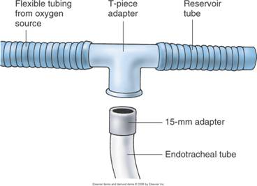
Spontaneous Breathing Trials
A period time in which ventilator support is ceased and the patient is breathing independently.
T-Tube Circuit
Can be used for patients with a tracheostomy.
Patients are disconnected from the ventilator.
Patients do not have to overcome the resistance of the ventilator, so they may be more comfortable.
However, they may become more anxious without pressure support.

Slide 13
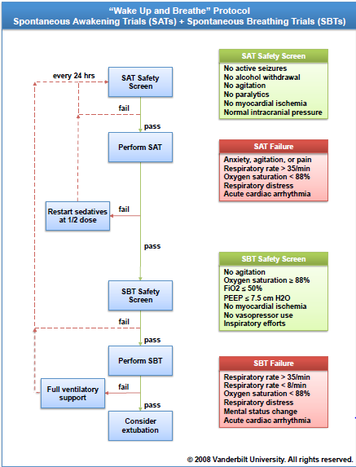
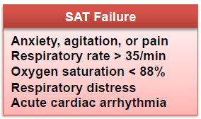
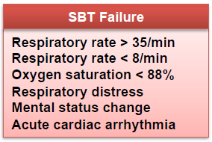

Slide 14
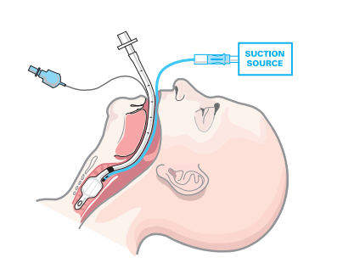
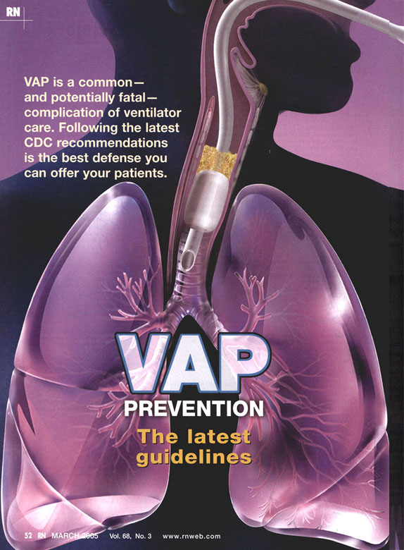
Subglottic Suctioning
Secretions accumulate here
Artificial airways reduce a patient’s ability to cough and clear secretions. Continuous suction through a lumen above the ETT cuff prevents accumulation and leakage of secretions that can cause ventilator associated pneumonia (VAP)

Slide 15
Oral Care in the Mechanically Ventilated Patient
Colonization of the respiratory and upper digestive tracts and aspiration of contaminated secretions are the primary cause of VAP.
Oral care is one of the most effective strategies for preventing ventilator-associated pneumonia (VAP).
Dental plaque can also be a reservoir for infectious respiratory pathogens.
Interventions that reduce VAP include:
Tooth brushing
Oral suctioning
Use of chlorhexidine oral rinse
Chlorhexidine creates a film that adheres to the teeth that provides antibacterial protection and treatment.

Slide 16
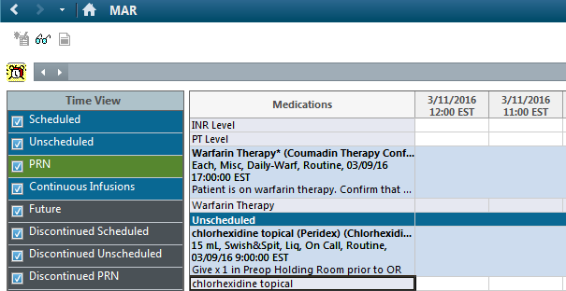
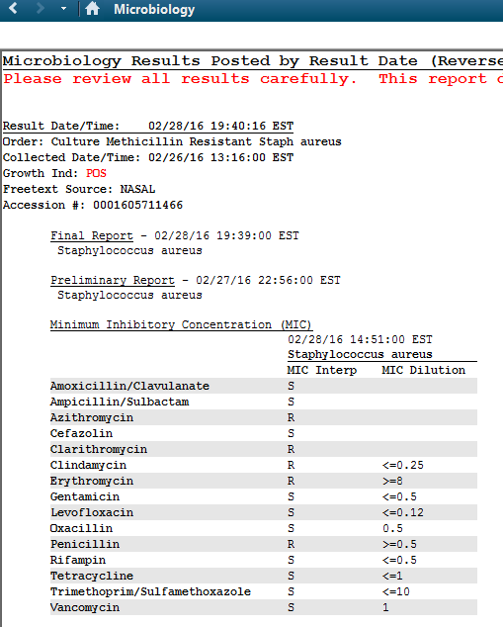
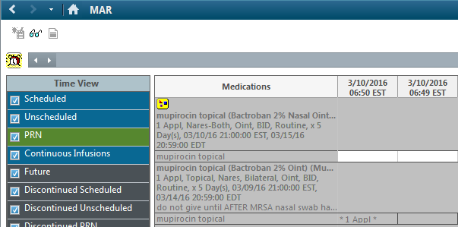
Now, Where do I Find This Stuff?
Preoperative Data Elements
Oral Preparation (e.g. Peridex / Chlorhexidine
This is a medication and should be documented on the MAR.
May also be found on pre-op nursing notes or anesthesia records.
Nasal Preparation
Nasal Culture results can be found with other labs or with microbiology results if your EMR has a separate micro section.
Mupirocin and any other treatment are medications and should be documented on the MAR.
May also be found on pre-op nursing notes or anesthesia record.

Slide 17
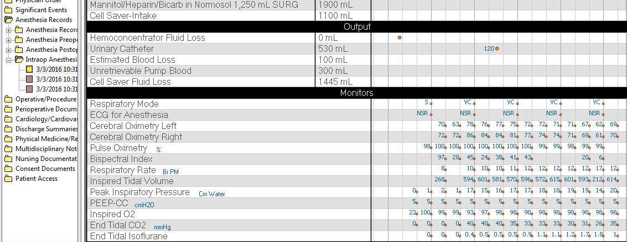
Now, Where do I Find This Stuff?
Intraoperative Data Elements
Lung Protective Ventilation
Usual TV Value = >200 and <800
Usual PEEP Value = >0 and <25
Found on the intraoperative anesthesia record.
Both inspired and expired tidal volume may be documented. If so, abstract the inspired volume, as this value is indicative of the size of the breath delivered to the patient.

Slide 18
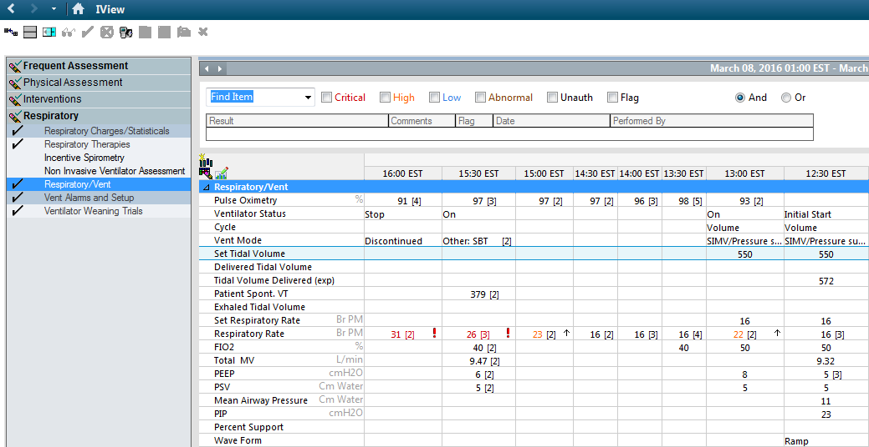
Now, Where do I Find This Stuff?
Postoperative Data Elements
Lung Protective Ventilation
Usual TV Value = >200 and <800
Usual PIP Value = <60
Found on the respiratory therapy ICU documentation.
Again, both inspired and expired tidal volume may be documented. If so, abstract the inspired volume, as this value is indicative of the size of the breath delivered to the patient.

Slide 19
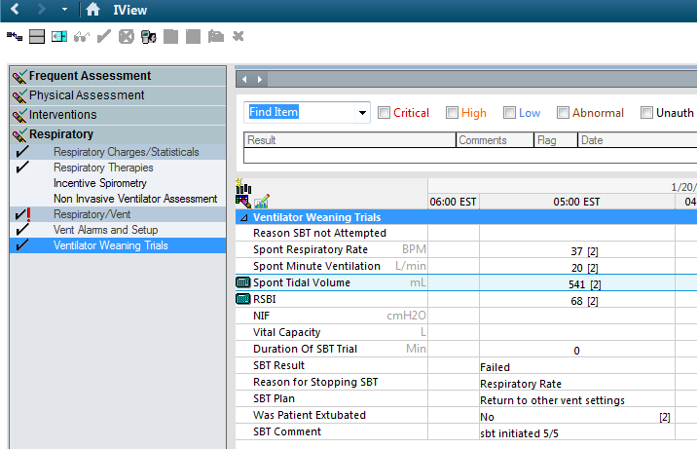
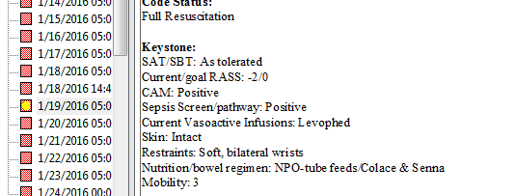
Now, Where do I Find This Stuff?
Postoperative Data Elements
Daily Assessment of oral care with CHG
Chlorhexidine is a medication and should be documented on the MAR.
May also be found in the ICU nursing notes or 24 hour flow sheet.
Daily SAT
Hourly infusion documentation, MAR, nursing notes, progress notes.
Daily SBT
Respiratory therapy documentation, nursing notes, progress notes.

Slide 20
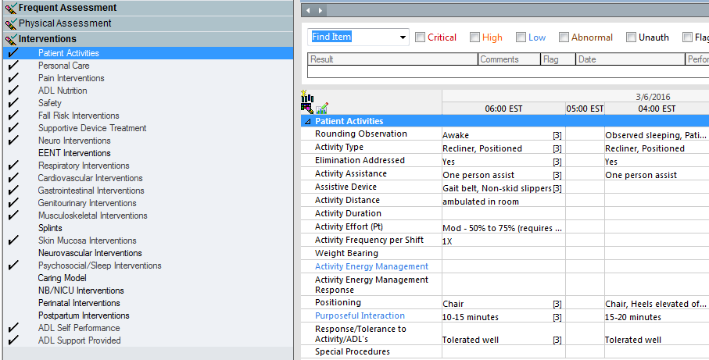
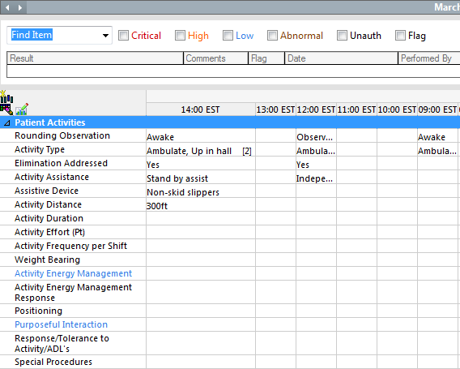
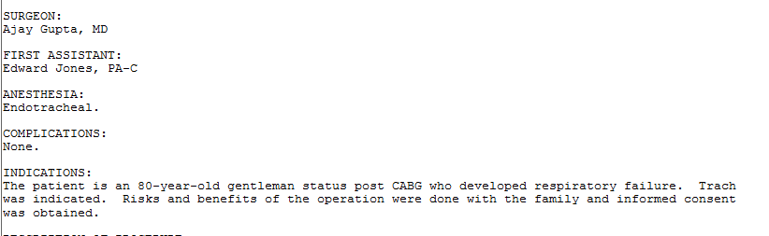
Now, Where do I Find This Stuff?
Postoperative Data Elements
Subglottic Suctioning
Documentation of type of ETT can be found in anesthesia charting, nursing notes, or hourly ICU documentation.
Reason for Reintubation
Progress notes, nursing notes, anesthesia notes.
Time to Chair
Hourly nursing documentation, physical therapy notes.
Time to Ambulation / Ambulation >150 feet
Hourly nursing documentation, physical therapy notes.
Bronchodilator Use
MAR, respiratory therapy notes.

Slide 21
Now, Where do I Find This Stuff?
Postoperative Data Elements
Subglottic Suctioning
Documentation of type of ETT can be found in anesthesia charting, nursing notes, or hourly ICU documentation.
Reason for Reintubation
Progress notes, nursing notes, anesthesia notes.
Time to Chair
Hourly nursing documentation, physical therapy notes.
Time to Ambulation / Ambulation >150 feet
Hourly nursing documentation, physical therapy notes.
Bronchodilator Use
MAR, respiratory therapy notes.

Slide 22
10. Alveoli - MMS Life Science. (n.d.). Retrieved February 28, 2016, from https://sites.google.com/site/igotcells/respiratory-system/11-alveoli
Both Spontaneous Awakening Trials (SAT) & Spontaneous Breathing Trials (SBT). (n.d.). Retrieved February 28, 2016, from http://www.icudelirium.org/both.html
Dickinson, S., & Zalewski, C. A. (n.d.). Oral Care During Mechanical Ventilation - Critical for VAP Prevention. Retrieved February 28, 2016, from http://www.sccm.org/Communications/Critical-Connections/Archives/Pages/Oral-Care-During-Mechanical-Ventilation---Critical-for-VAP-Prevention.aspx
Girard, T. D., Press, J. K., Fuchs, B. D., & Thomason, J. W. (2008). Efficacy and safety of a paired sedation and ventilator weaning protocol for mechanically ventilated patients in intensive care (Awakening and Breathing Controlled trial): A randomised controlled trial.
The Lancet, 371(9607), 126-134. Retrieved from http://www.thelancet.com/pdfs/journals/lancet/PIIS0140-6736(08)60105-1.pdf
Respiratory PEEP. (n.d.). Retrieved February 28, 2016, from https://www.youtube.com/watch?v=iuUSDR4ocCY
Respiratory Therapy Cave: Subglottic suctioning. (n.d.). Retrieved February 28, 2016, from http://respiratorytherapycave.blogspot.com/2014/06/subglottic-suctioning.html
Wake Up and Breathe!: An Expert Interview With Timothy D. Girard, MD, MSCI. Medscape. Dec 16, 2008.

